Slide 1


Mayank Nagar
17 April 2022

Slide 2

Outline
Executive Summary
Introduction
Methodology
Results
Conclusion
Appendix

Slide 3
Executive Summary
Summary of methodologies
Data collection using SpaceX API
Data collection with web Scraping
Data Wrangling
Exploratory Data Analysis with SQL
Complete EDA with Visualization
Interactive Visual Analytics with Folium and Dashboard using Ploty Dash
Building Machine Learning models
Summary of all results
Exploratory Data Analysis result
Interactive analytic screenshots
Machine learning predictions

Slide 4
Introduction
Project background and context
SpaceX says that launching a Falcon 9 rocket costs 62 million dollars. On the other hand, their competition costs 165 million dollars. The reason for this difference is that SpaceX can reuse the rocket in the first stage. Therefore we want to predict if a rocket will land on the first stage or not. This study aims to build a machine learning pipeline to predict the success of the first stage.
Problems you want to find answers
Determine a new rocket launch will be successful or not
Correlation between different feature and relation between various independent feature and depended feature
What is requirement conditions for a successful mission

Slide 5

Section 1

Slide 6
Methodology
Executive Summary
Data collection methodology:
Data was collected using SpaceX API and Web Scrapping form Wikipedia
Perform data wrangling
One Hot Encoding is applied to the numerical features
Perform exploratory data analysis (EDA) using visualization and SQL
Perform interactive visual analytics using Folium and Plotly Dash
Perform predictive analysis using classification models
How to build, tune, evaluate classification models

Slide 7
Data Collection
Data Collection stage mainly comprises two methods
Data Collection using SpaceX API
requests.get method is used to get data from SpaceX API and converted into JSON file
After this, the data is converted into pandas DataFrame using pd.json_normalize() method
We cleaned the data and the missing value in payload mass column was filled by the mean of the payload mass values
Data Collection using Web Scrapping from Wikipedia
BeautifulSoup library is used to scrap data from Wikipedia about Falcon 9 launch.
Launch records were extracted as HTML tables and converted into pandas DataFrame

Slide 8
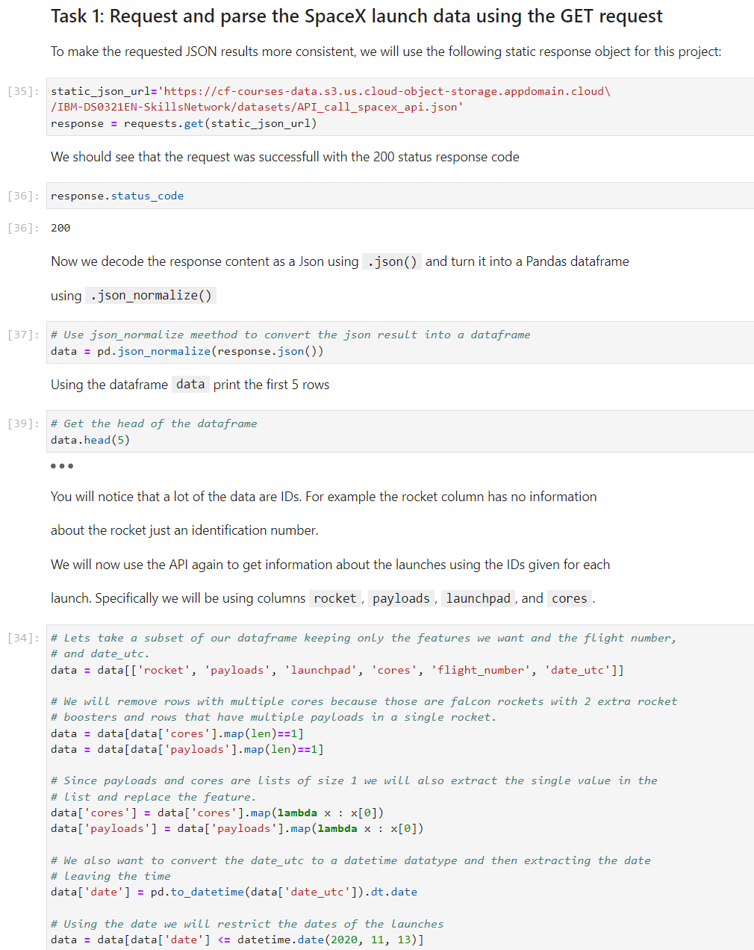
Data Collection – SpaceX API
We used requests.get method to collect the data from SpaceX API. We cleaned the data and converted into pandas DataFrame.
The GitHub URL of the completed SpaceX API calls notebook (https://github.com/nagar-mayank/Applied-Data-Science-Capstone-Project/blob/main/Notebooks/jupyter-labs-spacex-data-collection-api_--qgzCRlS.ipynb)

Slide 9
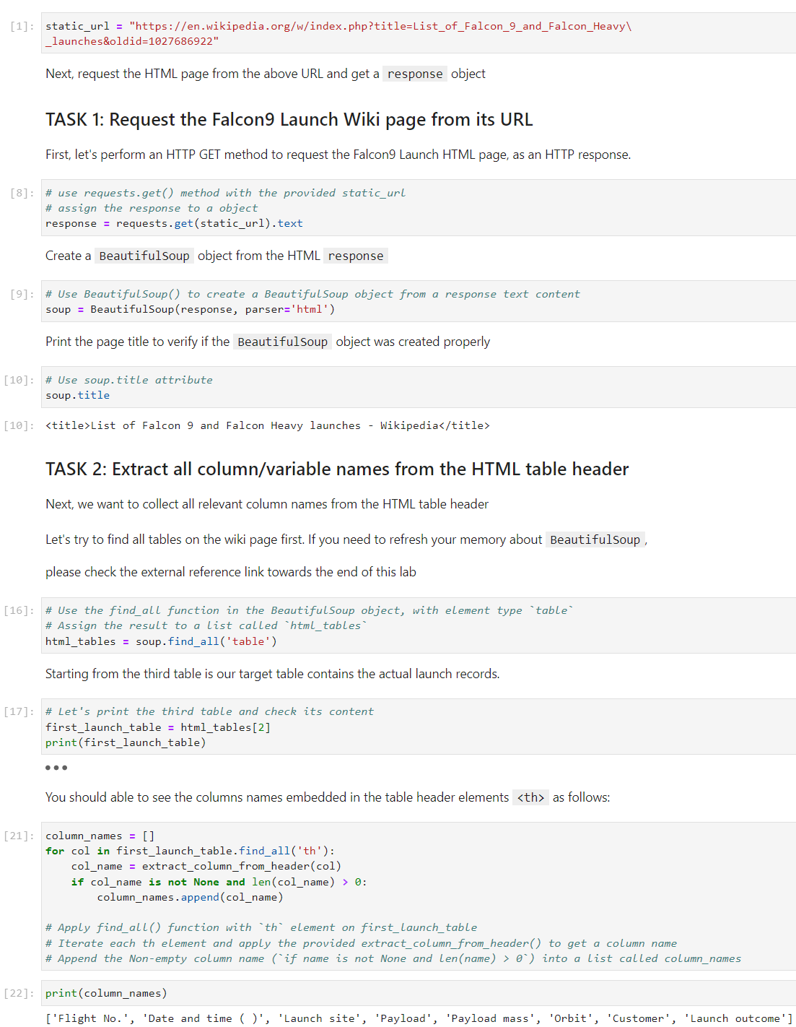
Data Collection - Scraping
We used BeautifulSoup library to get the data from Wikipedia about Falcon 9 rockets
We parsed the tables and converted into pandas DataFrame
The GitHub URL of the completed BeautifulSoup notebook (https://github.com/nagar-mayank/Applied-Data-Science-Capstone-Project/blob/main/Notebooks/jupyter-labs-webscraping_0LxDYKsUW.ipynb)

Slide 10
Data Wrangling
We calculated the number of launches on each site and the occurrence of each orbit
We calculated all the outcomes and converted into outcome label (0-1 class)
The GitHub URL of the completed Data Wrangling notebook (https://github.com/nagar-mayank/Applied-Data-Science-Capstone-Project/blob/main/Notebooks/Data_wrangling_ZekK73CQ9.ipynb)

Slide 11
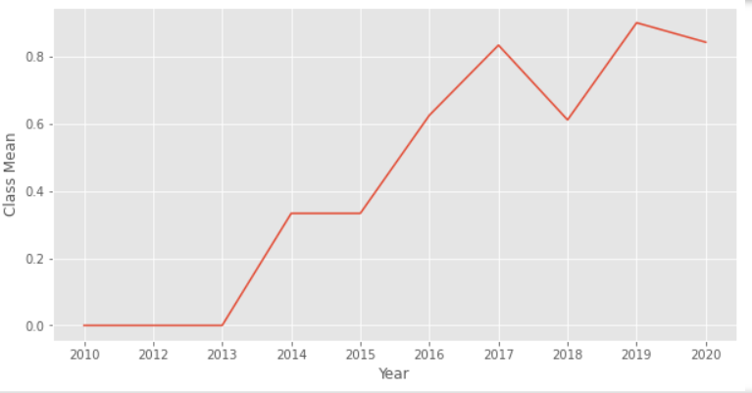
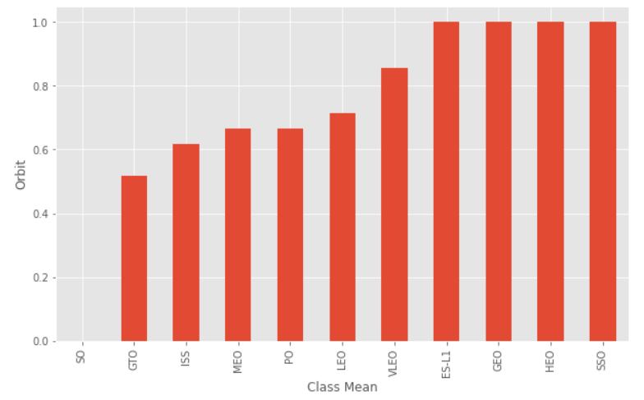
EDA with Data Visualization
We explored the data by visualizing the relation between ‘FlightNumber’ and ‘PayloadMass’, ‘FlightNumber’ and ‘LaunchSite’, ‘PayloadMass’ and ‘LauchSite’, ‘Orbit’ and ‘ClassMean’, ‘FlightNumber’ and ‘Orbit’, ‘PayloadMass’ and ‘Orbit’, ‘Year’ and ‘ClassMean’
The GitHub URL of the completed Data Visualization notebook (https://github.com/nagar-mayank/Applied-Data-Science-Capstone-Project/blob/main/Notebooks/eda-dataviz_fkU4Y76dt.ipynb)

Slide 12
EDA with SQL
We used Jupyter Notebook magic method to connect to the SQL database
We performed following tasks
Display the names of the unique launch sites in the space mission
Display 5 records where launch sites begin with the string 'CCA'
Display the total payload mass carried by boosters launched by NASA (CRS)
Display average payload mass carried by booster version F9 v1.1
List the date when the first successful landing outcome in ground pad was acheived.
List the names of the boosters which have success in drone ship and have payload mass greater than 4000 but less than 6000
List the total number of successful and failure mission outcomes
List the names of the booster_versions which have carried the maximum payload mass. Use a subquery
List the failed landing_outcomes in drone ship, their booster versions, and launch site names for in year 2015
Rank the count of landing outcomes (such as Failure (drone ship) or Success (ground pad)) between the date 2010-06-04 and 2017-03-20, in descending order
The GitHub URL of the completed SQL EDA notebook (https://github.com/nagar-mayank/Applied-Data-Science-Capstone-Project/blob/main/Notebooks/eda-sql-coursera_xN21VGyFr.ipynb)

Slide 13
Build an Interactive Map with Folium
We added all launch sites as circle object and markers with color based on the success of the mission.
Different color-based markers shows us which launch site has a relatively high success rate.
We calculated the distances between a launch site to its proximities.
The GitHub URL of the completed launch site location notebook (https://github.com/nagar-mayank/Applied-Data-Science-Capstone-Project/blob/main/Notebooks/launch_site_location.ipynb)

Slide 14
Build a Dashboard with Plotly Dash
We plotted a pie chart showing the total number of launches by a particular sites
We plotted a scatter plot showing the relation between Outcome and payloas mass for a particular booster version
The GitHub URL of the completed spacex dash app.py (https://github.com/nagar-mayank/Applied-Data-Science-Capstone-Project/blob/main/Notebooks/spacex_dash_app.py)

Slide 15
Predictive Analysis (Classification)
First, we standardize the dataset and split it into train and test dataset
Then, we searched the best parameters for LogisticRegression, SVM, DicisionTreeClassifier, KNeighboursClassifier using GridSearchCV from sklearn library
We used accuracy as the metric for the models
The GitHub URL of the completed Machine learning prediction Notebook (https://github.com/nagar-mayank/Applied-Data-Science-Capstone-Project/blob/main/Notebooks/SpaceX_Machine_Learning_Prediction_pmBMWQ6ia.ipynb)

Slide 16
Results
Exploratory data analysis results
Interactive analytics demo in screenshots
Predictive analysis results

Slide 17

Section 2

Slide 18
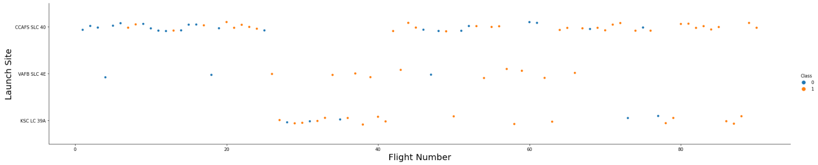
Flight Number vs. Launch Site
From the plot, it is clear that the larger the number of FlightNumber greater the success rate at the launch site

Slide 19
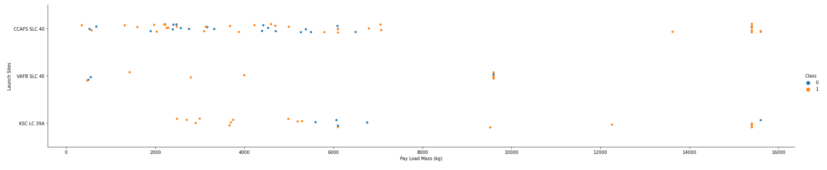
Payload vs. Launch Site
From the plot, it is clear that the larger the payload mass greater the success rate for CCAF5 SLC 40 Launch site and KSC LC 39A launch site had some unsuccessful mission when payload mass was around 6000 Kg

Slide 20
Success Rate vs. Orbit Type
From this bar chart, it is clear that satellites with SO Orbit have minimum successful missions and the satellites with ES-L1, GEO, HEO, SSO Orbits has maximum successful missions

Slide 21
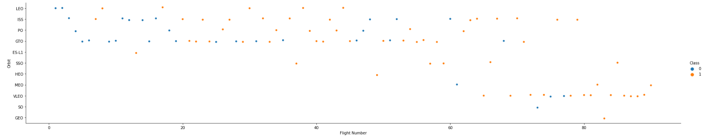
Flight Number vs. Orbit Type
From the plot it is clear that the success of the LEO Orbit satellite is related to the flight number and of the GTO Orbit satellite is not related to the flight number

Slide 22
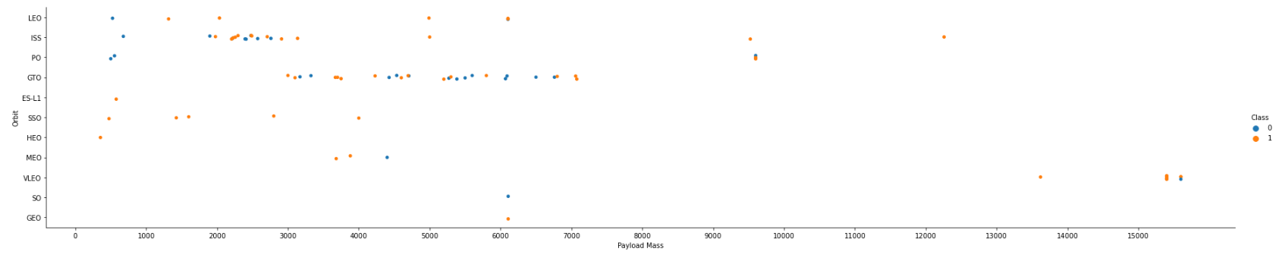
Payload vs. Orbit Type
From the plot, It is clear that the greater the payload mass greater the success rate of the LEO, ISS Orbit satellites

Slide 23
Launch Success Yearly Trend
From the line chart, it is clear that success rate is increasing over the years

Slide 24
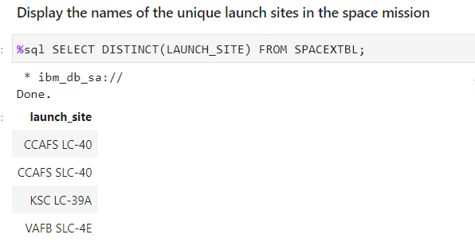
All Launch Site Names
We used DISTINCT keyword to get the distinct launch sites from the dataset

Slide 25
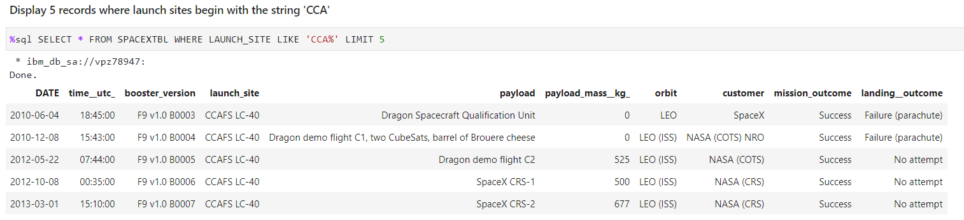
Launch Site Names Begin with 'CCA'
We used WHERE and LIKE keywords to get the 5 records where launch site start with “CCA”

Slide 26
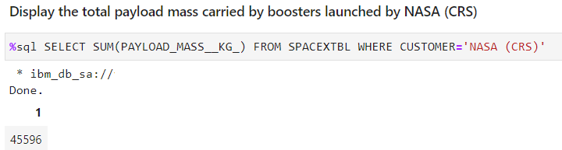
Total Payload Mass
We used SUM inbuild function to sum the payload mass

Slide 27
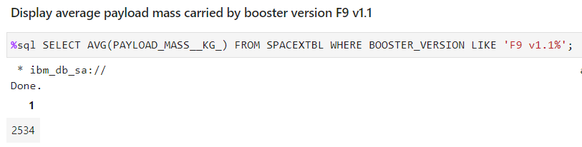
Average Payload Mass by F9 v1.1
We used AVG inbuild function to get the average of payload mass

Slide 28
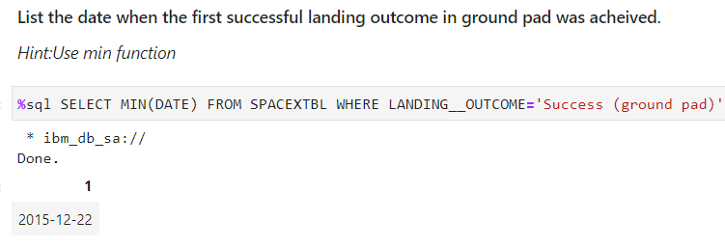
First Successful Ground Landing Date
We used the MIN inbuild function to get the first date on which the landing outcome in the ground pad was successful

Slide 29
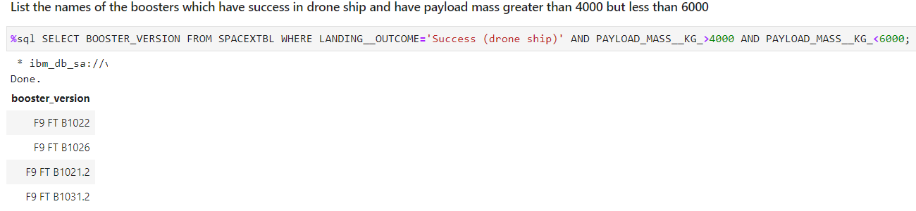
Successful Drone Ship Landing with Payload between 4000 and 6000
We used WHERE and AND keywords to get the successful drone ship landing with payload between 4000 and 6000

Slide 30
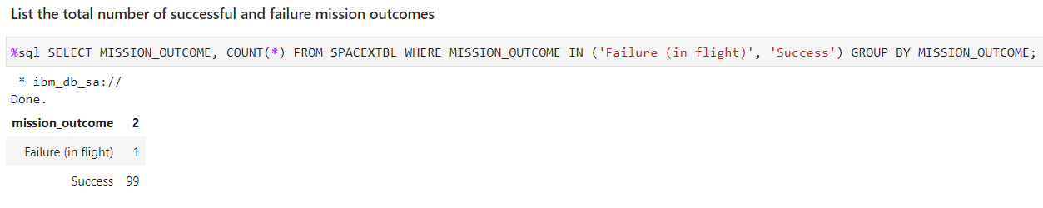
Total Number of Successful and Failure Mission Outcomes
We used the COUNT inbuilt function and grouped by mission outcome column using GROUP BY keyword

Slide 31
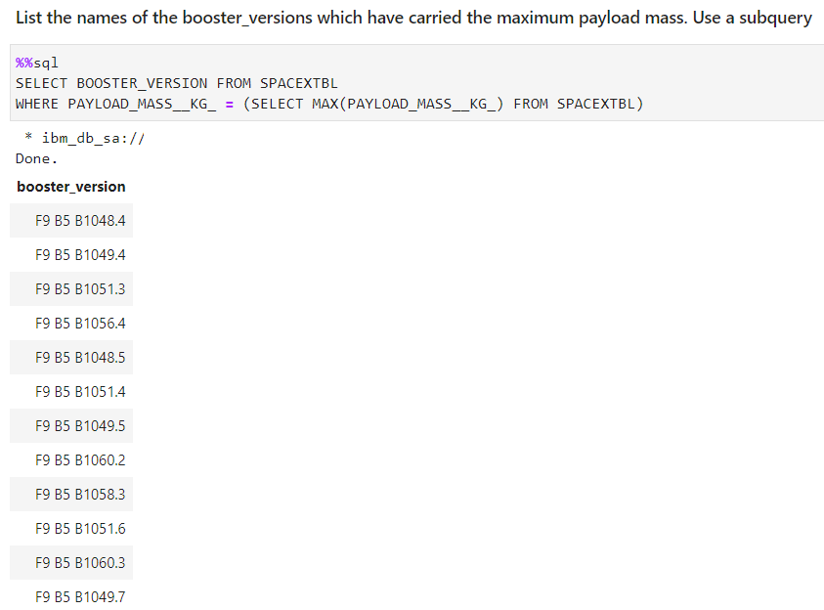
Boosters Carried Maximum Payload
We used subquery to get the names of boosters carried maximum payload

Slide 32
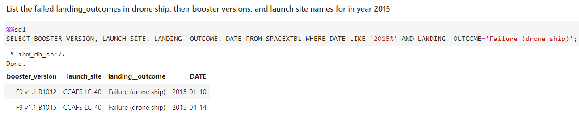
2015 Launch Records
We used LIKE and AND keywords in WHERE clause to get the results

Slide 33
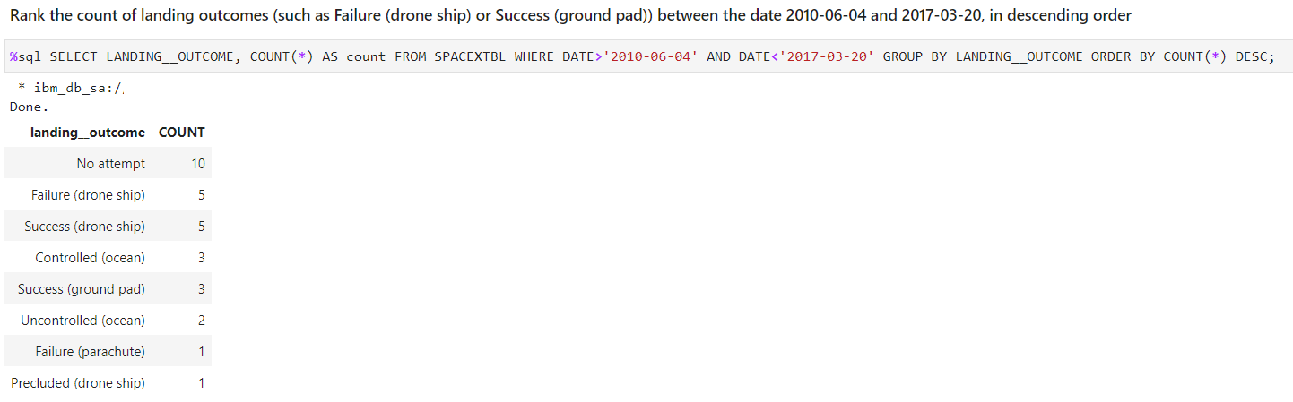
Rank Landing Outcomes Between 2010-06-04 and 2017-03-20
We used AND keyword in the WHERE clause and the further result is grouped by landing outcome and sorted by the count

Slide 34

Section 3

Slide 35
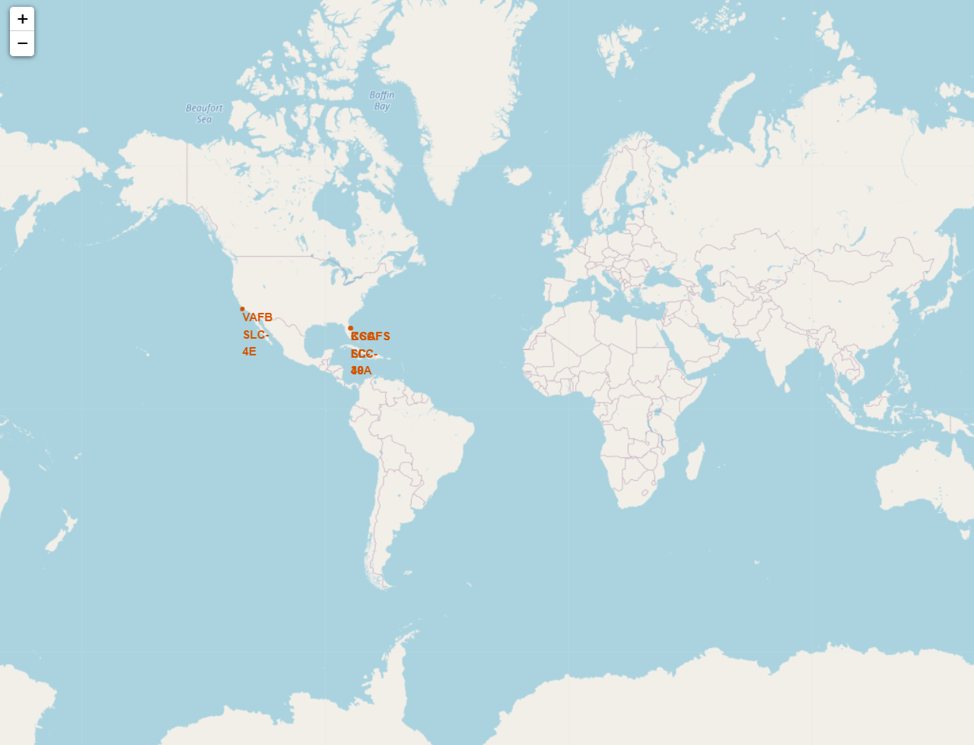
All Launch Sites on A Global Map
From this map, we can see that all launch sites are on the United States of America’s coasts

Slide 36
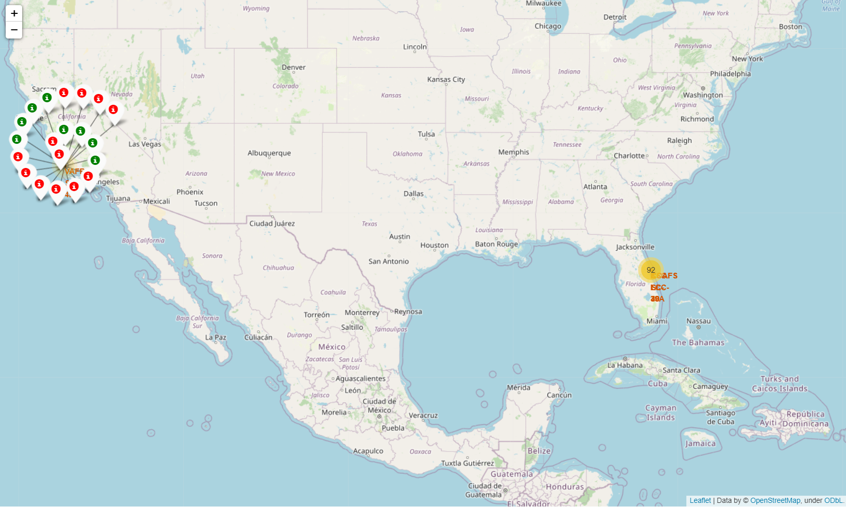
Color Markers Showing Outcome of a Launch for a Launch Site
Green Markers shows a successful mission and Red Markers shows a unsuccessful mission

Slide 37
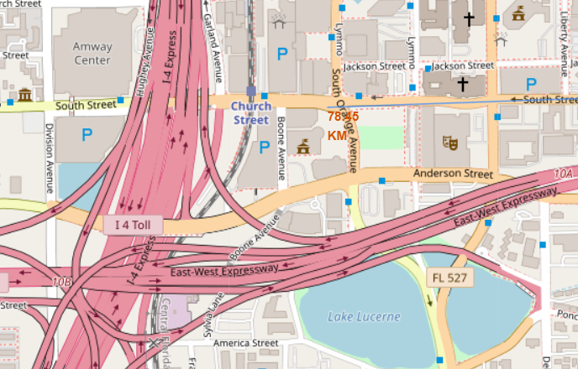
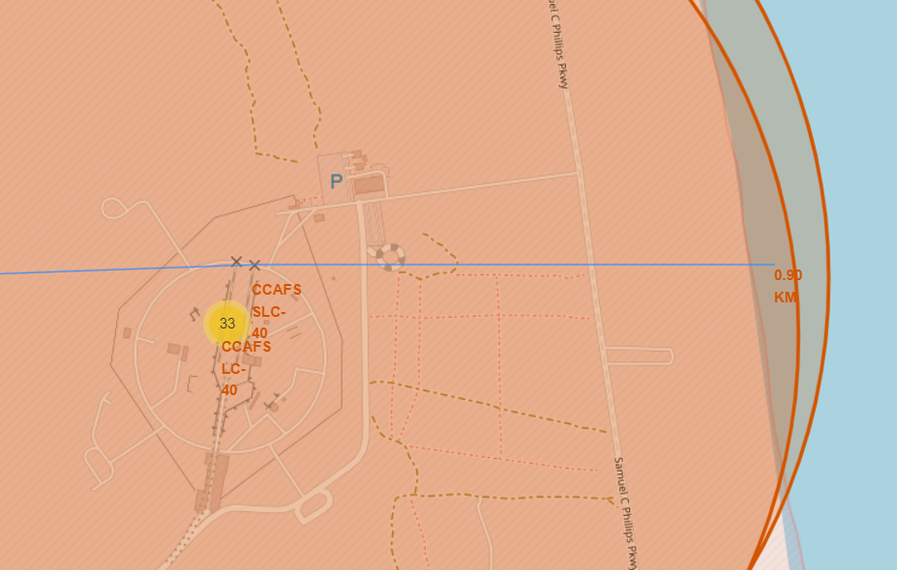
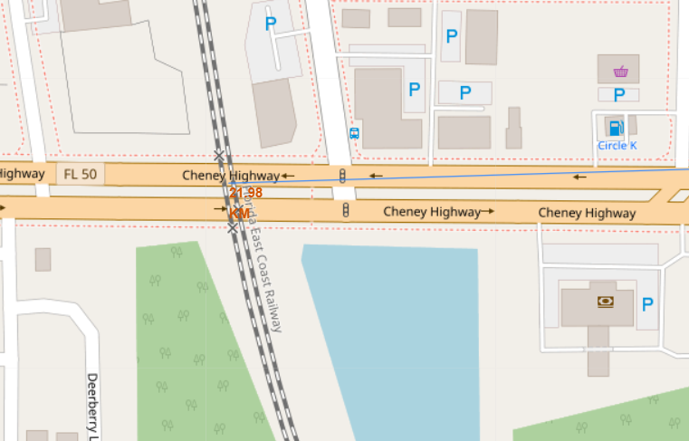
Launch Site distances to landmarks
Distance from the nearest highway is 78.45 KM
Distance from the coastline is 0.90 KM
The distance from the nearest railway line is 28.98 KM
It is essential for the safety of civilians that the launch site is at a proper distance from all city’s landmarks and crowded area

Slide 38

Section 4

Slide 39
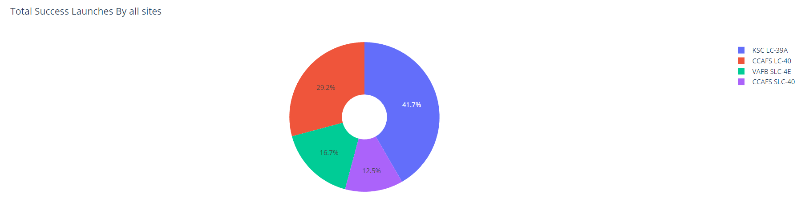
Pie Chart of Launch Success for All Sites
From the pie chart, it is clear that KSC LC-39A has the most successful missions

Slide 40
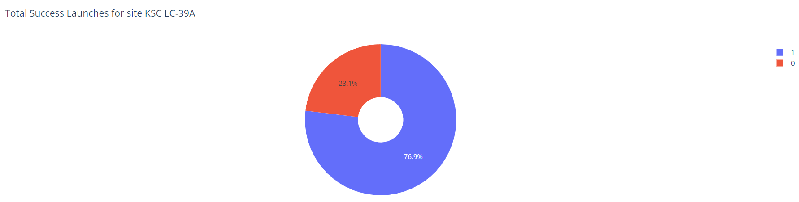
Pie Chart of Highest Success Rated Site
From the pie chart, it is clear that KSC LC-39A has 76.9% success rate

Slide 41
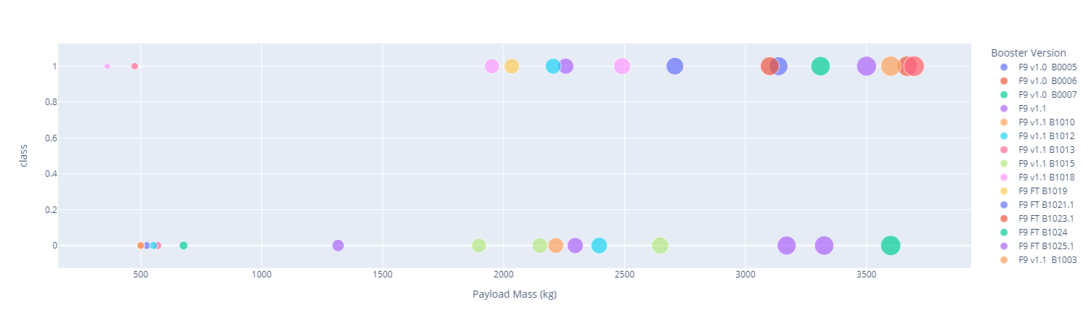
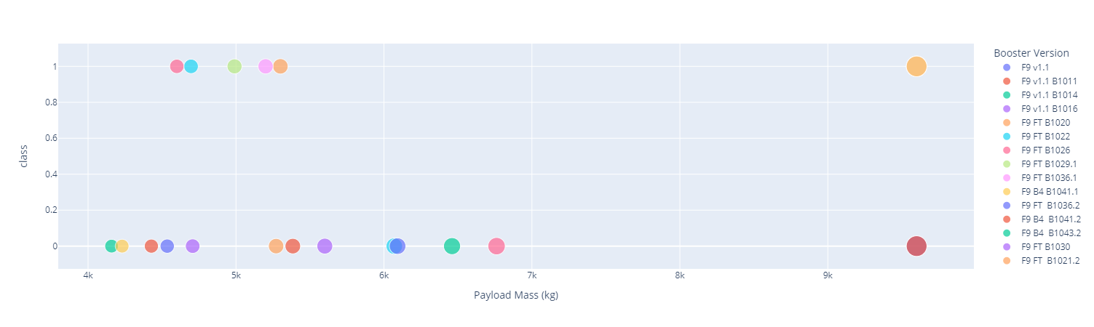
Scatter Plot for Different Payload Ranges
Low weighted payload (<4000 KG)
High weighted payload (4000<10000 KG)
From the scatter plot, it is clear that mission with low payload weight is higher than high payload weight.

Slide 42

Section 5

Slide 43
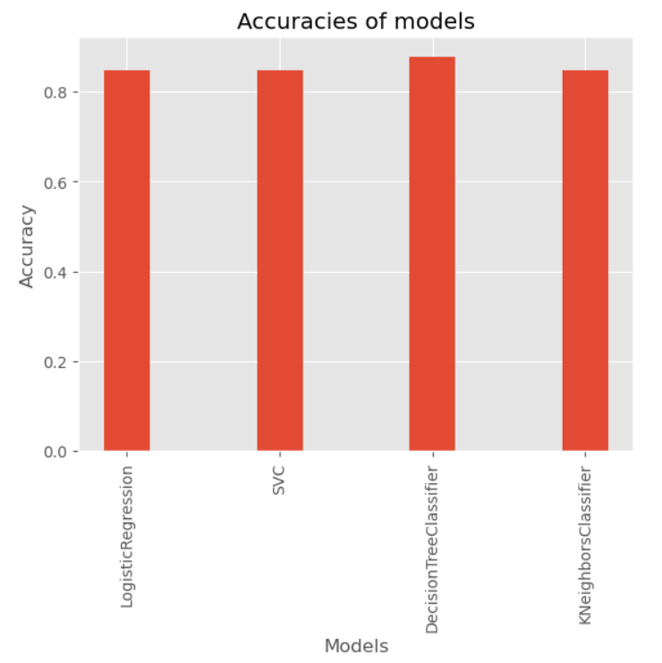
Classification Accuracy
From the bar chart, it is clear that Decision Tree Classifier has the highest accuracy.

Slide 44
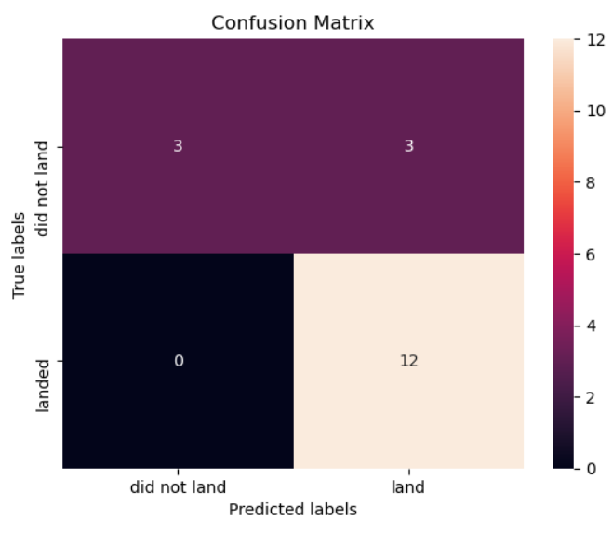
Confusion Matrix
From the Confusion Matrix of Decision Tree Classifier, it is clear that it is very robust when class is 1. The model struggles with False Positives

Slide 45
Conclusions
From this study, we can conclude that
Larger the Flight Number greater the success rate
Mission success rate is increasing from 2013 till 2020
KSC LC-39A has the most successful rate over all sites
The Decision Tree Classifier is the best model to predict the success of the mission

Slide 46


